Slide 1
A New Hotel in the Bronx
Andrea Gualdoni

Slide 2

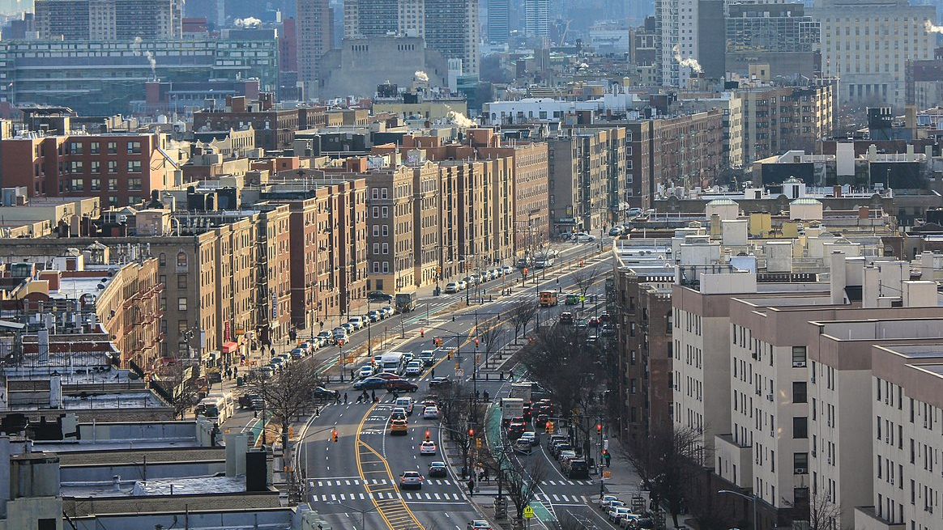



I don’t need bodyguards. I`m from the South Bronx. Al Pacino

Slide 3

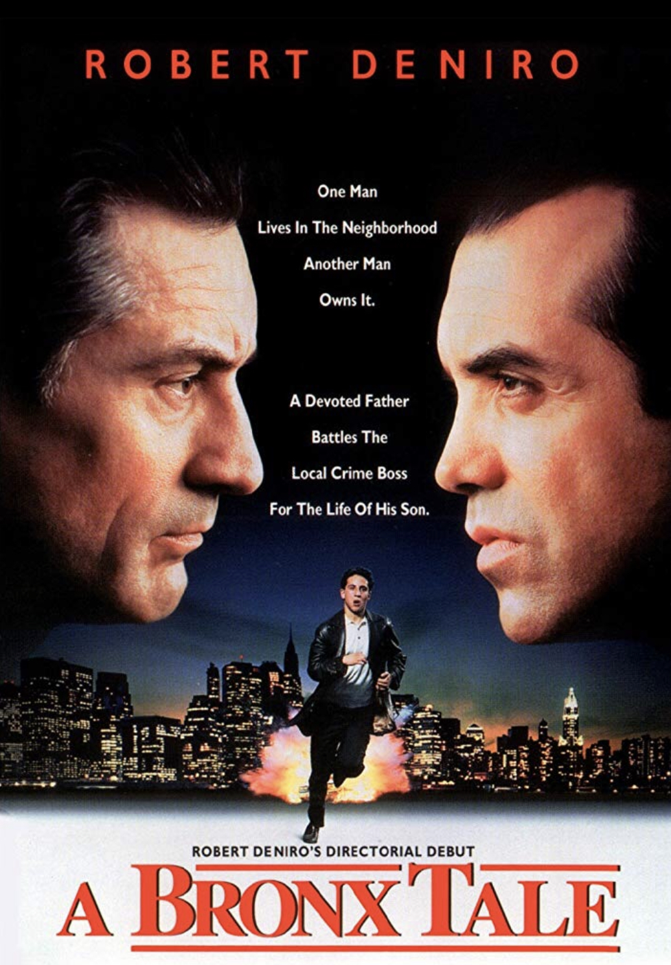
Background
A Customer came to me after seeing the De Niro Movie `A Bronx Tale`. Since nowadays there are regulatory facilitating the rent/ownership of building in the Bronx he asked me to give him advice on `Where to open a hotel?` there. To be profitable the variable to consider are:
Lack of competitors in the same neibourhoo
Not be too far from Time square since tourists usually float around Manhattan

Slide 4
Data Collection and Methodology
We will need:
a dataset on New York city neighborhoods and hotel data from the FourSquare location platform.
Calculate distance from each Bronx neighborhood to Manhattan.
Distance + Hotel Data clustered to determine the ideal neighborhood (K-mean will be used)
Location data and hotel data will be obtained from the website https://geo.nyu.edu/catalog/nyu_2451_34572 and the FourSquare database respectively.

Slide 5
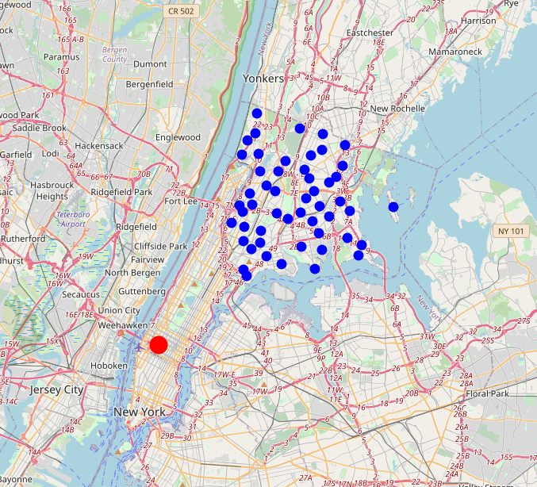
Bronx Neighborhood
Using Folium for Pyton I draw on the map the following information:
Red Dot: Times Square
Blue Dots: Bronx Neighborhood

Slide 6
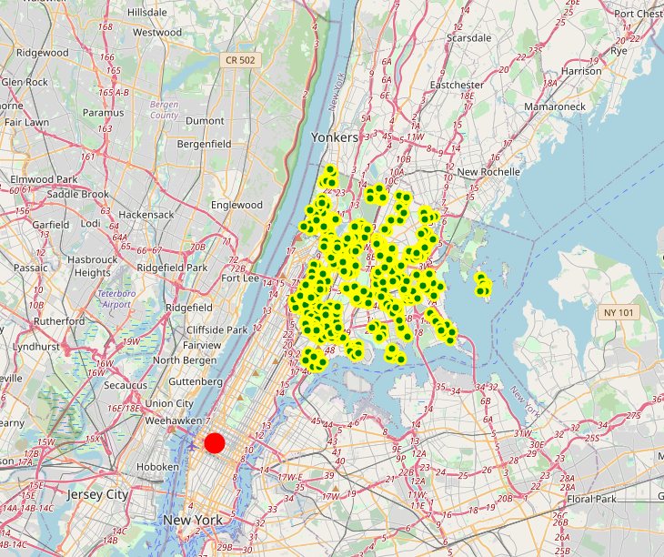

Using Foursquare API we retrieved the list of all venues in the Broxn
On the right you can have a rendering of them on the map

Slide 7
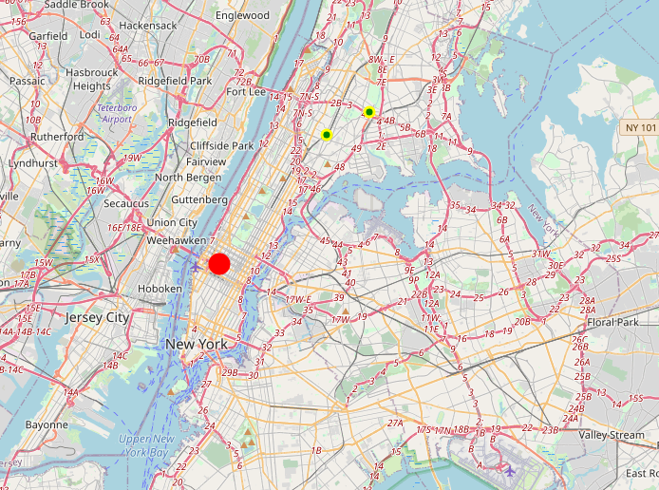
Lots of business around but when we breakdown the venues by type we notice that only 4 hotels are placed in the Bronx.
This because the district has a high rate of criminality and tourist are not attracted.
With this new policy promoting Bronx lets check neibourghood without competitors and near Time Square

Slide 8
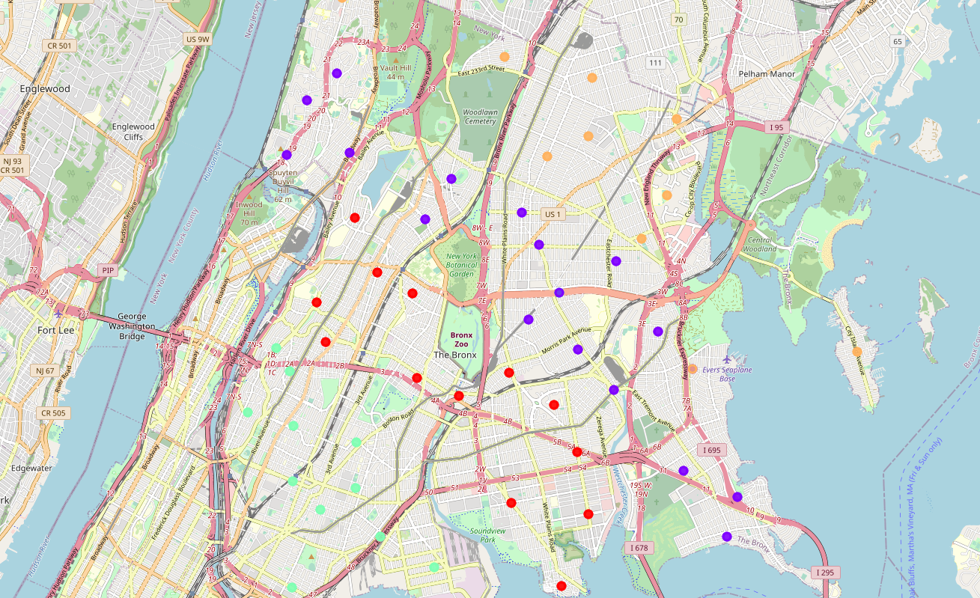
Clustering
Next step in my analysis was to calculate the distance between every Neighborhood of the Bronx to Time Square with Haversine Formula.
We cluster the Neighborhood of Bronx with K-Means (k=5)
A visualization of the cluster appears in the image on the right

Slide 9
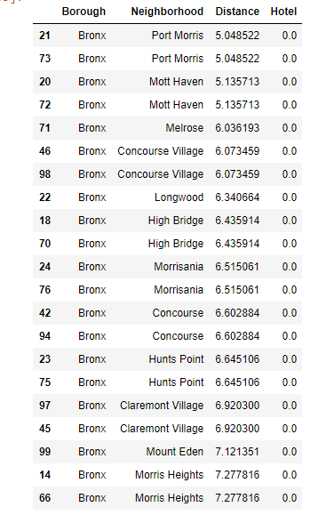
Conclusion
After carefully analyzing each cluster, it appears that cluster 3 satisfied our condition of neighborhoods closest to Manhattan with the minimum number of competitors.
Looking deeper into cluster 3 we can narrow our choices down to neighborhoods like Port Morris and Mott Haven where the distance to Manhattan is ~5km and no competition is there.

